Slide 1
Thomas Aquinas Aesthetics
Dr. Stephanie Spoto
3/13/2019
Monterey Peninsula College
Gentrain 405: The Medieval World, Part I

Slide 2
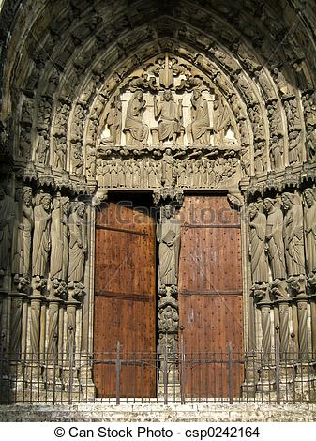
Medieval Aesthetics
The term “aesthetics” didn’t arise until 18th century
However, discussion on aesthetics began in antiquity.
Focus on symbolism, light, and proportion → evident in medieval cathedrals

Slide 3
Thomas Aquinas and notions of Beauty
Focused his work mostly on the notion of beauty.
However, he did not say enough to have a detailed system; his views are extracted from what he did say.
Today will outline the definition and the standards of beauty.

Slide 4
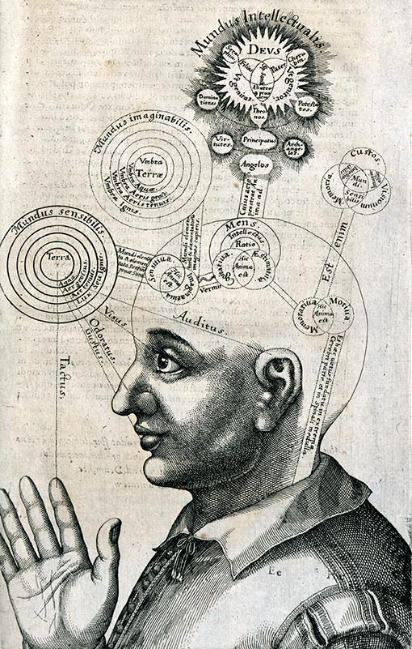
Definition of beauty
Aquinas defines beauty: beauty is that which gives pleasure when seen (Summa Theologiae).
Different than a subjective understanding of beauty.
Ambiguity comes from “seen” → different connotations in English
Not the same as glance or notice (since they imply a passive account of seeing).
“Seen” here more closely associated with activity of contemplation.

Slide 5
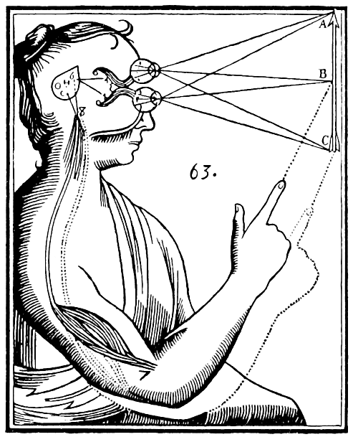
Beauty as seen Explanation by Jacques Maritain
Beauty is essentially the object of intelligence, for what knows in the full meaning of the word is the mind, which alone is open to the infinity of being. The natural site of beauty is the intelligible world: thence it descends. But it falls in a way within the grasp of the senses, since the senses in the case of man serve the mind and can themselves rejoice in knowing: ‘the beautiful relates only to sight and hearing of all senses, because these two are maxime cognoscitive.’ (Jacques Maritain, Art of Scholasticism, 1930, p. 23)

Slide 6
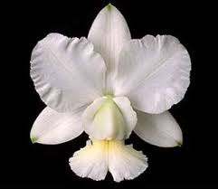
Material vs. immaterial form: the mind recognizes beauty
Knowing beauty is an activity of the mind
For Aquinas, knowledge (in general) is when the form of the object (without its matter) is in the mind of the knower
Step 1: Look at the flower. Allow the flower to be received by your physical senses (sight)
Step 2: The very same form of the flower (immaterial) in reality outside the mind is received by sight and then exists in your mind. Now you have knowledge, since the form exists in your mind
Step 3: Contemplate the form to discover its beauty
Step 4: You react: “The ______ is ________________.” (It is the mind, not the senses that recognize beauty.
Beauty exists in the form of the object. It exists in objective reality. It is not merely subjective. Sight & hearing most important for discovering beauty.

Slide 7
Criteria for assessing beauty?
Aquinas believed there was set of criteria for assessing beauty, but it was not precise → more like guideposts to help minds (finite) apprehend beauty (infinite).
Do not all have to be present for beauty, and possessing one does not guarantee beauty.
For Thomas, beauty has four primary standards: actuality, proportion, radiance, and integrity. Related to the Trinity (especially the Son):
Integrity: “has in Himself truly and perfectly the nature of the Father.”
Proportion “inasmuch as He is the express Image of the Father.”
Radiance: “which is the light and splendor of the intellect.”

Slide 8
Actuality Criteria for assessing Beauty
Actuality
Proportion
Radiance
Integrity
Actuality is the ultimate basis and source for reality, and is therefore the ground of beauty.
Beauty grounded in actual existence of object
All objects in existence will have some variance of degree of Beauty (even if very little)
If the object doesn’t exist then it is nothing → therefore not beautiful.
Form and action both aspects of actuality.
Form: separates the existence of different things (dog, man, etc.) → more goodness the higher perfection of form
Action: Necessary for something to be beautiful → dancer most beautiful when dancing (most complete in actuality)

Slide 9
Proportion Criteria for assessing Beauty
Actuality
Proportion
Radiance
Integrity
Proportion, balance, symmetry.
Plotinus already noted that proportion was not sole criterion for Beauty, but medieval philosophers thought important component of Beauty
According to Armand Maurer: “We have only to think of the symmetry of the petals of an orchid, the balance of a mathematical equation, the mutual adaptation of the parts of a work of art, to realize how important the factor of harmony is in beauty” (Maurer, 10-11).

Slide 10
Radiance Criteria for assessing Beauty
Actuality
Proportion
Radiance
Integrity
“Radiance belongs to being considered precisely as beautiful: it is, in being, that which catches the eye, or the ear, or the mind, and makes us want to perceive it again” (Etienne Gilson, 2000, 35).
Difficult to put finger on → a kind of luminosity emanating from beautiful object → seizes attention of beholder.
Characteristic that catches the eye, makes us want to continue looking
Connected to medieval understanding of light:
Natural light: paintings lose some of their brilliance with lights turn off (no longer being perceived)
Divine light: Connecting beauty to the beauty of God: “All form, through which things have being, is a certain participation in the divine clarity [or light]. And this is what [Dionysius] adds, that particulars are beautiful because of their own nature – that is, because of their form” (Thomas, Commentary on the Divine Names, IV.6).

Slide 11
Integrity/Wholeness Criteria for assessing Beauty
Actuality
Proportion
Radiance
Integrity
Two aspects to Wholeness:
Wholeness requires existence: that nothing essential is lacking
“The first meaning of this term, for St. Thomas, is existential: it expresses the primal perfection of a thing, which is found in its existence (esse)”.
Wholeness requires action: Lacks nothing in its ability towards completion → the perfectly beautiful must be perfectly actualized
If something essential to the completion of its nature is lacking then it is imperfect: “The 'first' perfection is that according to which a thing is substantially perfect, and this perfection is the form of the whole; which form results from the whole having its parts complete” (ST I.73.1).

